Slide 1

Generalized estimating equation: analysis of longitudinal data
Shah Mohammad Fahim, MBBS, MPH
Assistant Scientist, icddr,b
Mobile: +8801912682540
E-mail: mohammad.fahim@icddrb.org

Slide 2
Overview
Longitudinal Data
Generalized Estimating Equation
Correlation Structure in GEE
Common distributions and link function
Model Selection in GEE
Example
Exercise using Stata

Slide 3
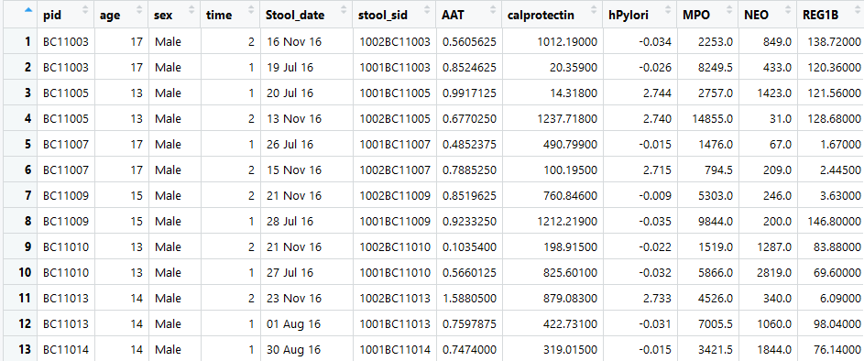
Longitudinal data
Data that is collected through a series of repeated observations of the same subjects over some extended time frame

Slide 4
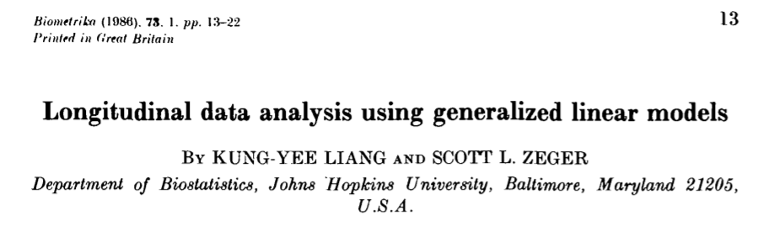
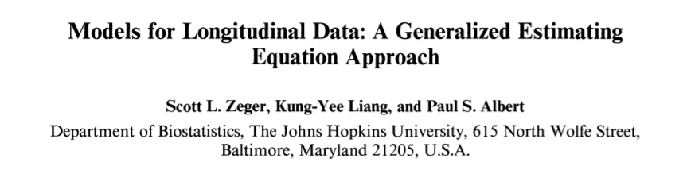
Analysis for longitudinal data

Slide 5
Generalized estimating equations
Generalized Estimating Equation (GEE) is an extension of GLM
GEE provide a method of inference for a wide variety of models when responses are correlated
Generalization of the GLM to allow repeated measures
Assumption of independence between observations is likely to be violated in longitudinal data
Models that ignore assumption tend to produce incorrect Standard Errors and p-values for regression coefficient

Slide 6
Generalized estimating equations
GEE is useful when the aim is to investigate differences in population averaged responses
GEE offers robust estimation of standard errors
Parameter estimates from the GEE are consistent even when the covariance structure is mis-specified
GEE is a ‘population-averaged’ approach that models marginal distributions (as opposed to ‘subject-specific’ modeling)
The standard GEE method is valid if the data are missing completely at random (MCAR)

Slide 7
Effect on SE for GEE
Ignoring dependency of the observations overestimates the standard errors of time-dependent predictors (such as LAZ)
Standard errors of time-independent predictors (such as sex) is underestimated
Empirical Standard Error Estimates
Parameter | Estimate | Standard Error | 95% Confidence Limits |  | Z | Pr > |Z|
Intercept | 38.2431 | 4.9704 | 28.5013 | 47.9848 | 7.69 | <.0001
dopa | -0.0129 | 0.0026 | -0.0180 | -0.0079 | -5.00 | <.0001
time | -0.0775 | 0.2829 | -0.6320 | 0.4770 | -0.27 | 0.7841
In OLS analysis, standard error for time parameter was: 0.64946→ It’s cut by more than half here.
In OLS analysis, the standard error for the chemical coefficient was 0.00550 → also cut in half here.

Slide 8
Generalized estimating equations
GEE can handle normal and non-normal outcome data with better performance when outcome is continuous
Takes into account for correlated observations
Correction for within subject correlations is carried out by assuming a priori a correlation structure for the repeated measurements
GEE is fairly robust against a wrong choice of correlation matrix—particularly with large sample size
Handles the missing data and only lose the observations that the subject is missing, not all measurements

Slide 9
Correlation structure in GEE
GEE takes into account the within-subject dependency (i.e. correlations) of observations by specifying a ‘working correlation structure’
Adjustment for within-subject correlation is carried out by assuming a ‘correlation structure’ for the repeated measurements a priori
Choices include:
Independent
Exchangeable
Autoregressive
Unstructured

Slide 10
Types of correlation between observations
Independence (no correlation) – do not need GEE correlations(indep)
Exchangeable – within a cluster any two observations are equally correlated, but no correlation between observations from different clusters correlations(exc)
Autoregressive – repeated measures that are mostly strongly correlated when close together in time and least correlated when furthest apart in time correlations(ar1)
Unstructured–no constraints are placed on correlations correlations(uns)
Notes:
Any two distinct observations from the same patient have the same correlation coefficient

Slide 11
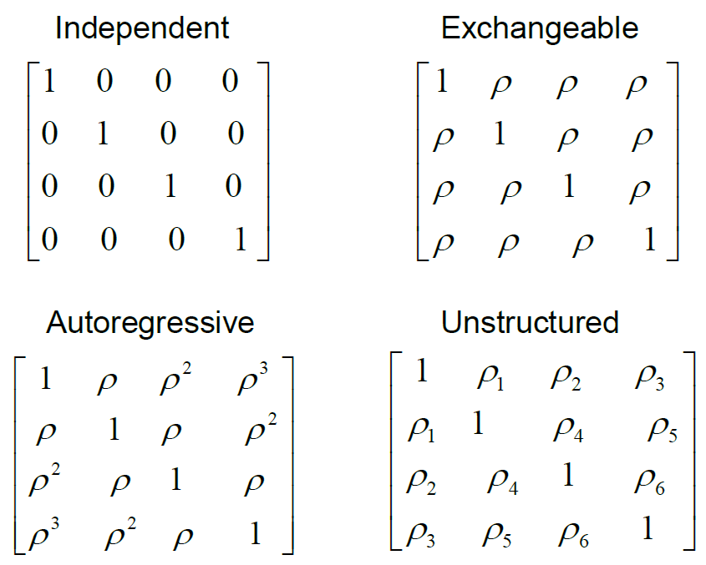
Types of correlation between observations
Notes:
Any two distinct observations from the same patient have the same correlation coefficient

Slide 12
Common distributions and link function
Distribution | Uses | Link function
Normal | Linear-response data | Identity
Gamma | Exponential-response data, scale parameters | Negative inverse
Poisson | Count of occurrences in fixed amount of time/space | Log
Bernoulli | Outcome of single yes/no occurrence | Logit
Binomial | Count of # of "yes" occurrences out of N yes/no occurrences | Logit
Categorical | Outcome of single K-way occurrence | Logit
Multinomial | Count of occurrences of different types (1 .. K) out of N total K-way occurrences | Logit

Slide 13
Common distributions and link function
Distribution | Uses | Link function
Normal | Linear-response data | Identity
Gamma | Exponential-response data, scale parameters | Negative inverse
Poisson | Count of occurrences in fixed amount of time/space | Log
Bernoulli | Outcome of single yes/no occurrence | Logit
Binomial | Count of # of "yes" occurrences out of N yes/no occurrences | Logit
Categorical | Outcome of single K-way occurrence | Logit
Multinomial | Count of occurrences of different types (1 .. K) out of N total K-way occurrences | Logit

Slide 14
Model selections in GEE
Quasi-Information Criteria (QIC) can be used to –
select the correlation structure [QIC]
determine the best subsets of covariates for a particular model [QICu]
Best model is the one with the with the smallest value of QIC
A Stata program qiccan offer both QIC and QICu in GEE
Notes:
Any two distinct observations from the same patient have the same correlation coefficient

Slide 15

Example
H. pylori infected children had higher fecal concentrations of AAT and lower concentrations of REG1B in non-diarrheal stool samples
H. pylori infection was not associated with nutritional status of children with stunting or at risk of being stunted

Slide 16
Statistical analysis
We examined association between H. pylori infection and stool biomarker concentrations using multivariable linear regression with generalized estimating equations (GEE)
Then examined the association between H. pylori infection and nutritional status in children
Family was Gaussian, link function was identity and correlation matrix was unstructured
Multicollinearity among independent variables in each model was checked
All models were adjusted for age, sex and nutritional status

Slide 17
Association of H. pylori with EED biomarkers
Adjusted β (95% CI) | MPO | NEO | AAT | Calprotectin | REG1B
H. pylori infection | 0.14 (-0.11, 0.39) | -0.02 (-0.26, 0.23) | 0.26 (0.02, 0.49)* | -0.07 (-0.34, 0.20) | -0.32 (-0.59, -0.05)*
Age | -0.02 (-0.07, 0.03) | -0.05 (-0.10, -0.01)* | - 0.01(-0.05, 0.04) | -0.02 (-0.07, 0.04) | -0.08 (-0.13, -0.02)*
Sex (female) | 0.12 (-0.09, 0.33) | 0.03 (-0.18, 0.24) | - 0.14 (-0.34, 0.06) | 0.02 (-0.20, 0.25) | 0.12 (-0.10, 0.35)
At risk of stunting | -0.02 (-0.24, 0.19) | 0.06 (-0.15, 0.28) | - 0.07 (-0.27, 0.13) | -0.10 (-0.33, 0.12) | -0.03 (-0.25, 0.20)
Mother received education | 0.20 (-0.07, 0.47) |  | 0.19 (-0.06, 0.45) |  | 0.28 (0.01, 0.56)*
Separate space for kitchen |  | -0.24 (-0.56, 0.08)
Animal exposure in household |  |  |  | -0.42 (-0.84, -0.002)
Crowding | 0.15 (-0.10, 0.40) |  | 0.01 (-0.22, 0.23)
Water treatment
Always wash hand after child defecation |  | -0.14 (-0.39, 0.11) |  |  | -0.19 (-0.42, 0.04)
Always wash hand after toilet | 0.26 (0.02, 0.49)* | 0.01 (-0.27, 0.29)
CRP | 0.02 (-0.01, 0.04) | -0.03 (-0.05, -0.01)* | 0.21 (-0.03, 0.45) | 0.01 (-0.01, 0.04)
AGP | 0.001 (-0.001, 0.003) |  | - 0.09 (-0.33, 0.15) | 0.003 (0.001, 0.005)*
*p-value < 0.05

Slide 18
Association of H. pylori with Nutritional status
Adjusted β (95% CI) | LAZ | WAZ | WLZ
Age | 0.004 (-0.02, 0.03) | -0.01 (-0.05, 0.03) | -0.03 (-0.08, 0.02)
Sex (female) | 0.07 (-0.04, 0.19) | 0.17 (-0.01, 0.35) | 0.21 (0.01, 0.41)*
At risk of stunting | 1.18 (1.06, 1.29)* | 0.74 (0.55, 0.92)* | 0.14 (-0.07, 0.35)
Mothers received education | 0.27 (0.12, 0.42)* | 0.28 (0.04, 0.52)* | 0.18 (-0.09, 0.46)
Household head received education | 0.10 (-0.03, 0.24) | 0.17 (-0.05, 0.39) | 0.15 (-0.09, 0.40)
Separate space for kitchen | -0.08 (-0.25, 0.09) | -0.08 (-0.36, 0.20) | 0.04 (-0.28, 0.36)
Water treatment | -0.05 (-0.17, 0.08) | 0.17 (-0.02, 0.37) | 0.25 (0.03, 0.48)*
Improved sanitation |  | 0.10 (-0.09, 0.29) | 0.19(-0.02, 0.41)
Always wash hand after toilet | 0.08 (-0.05, 0.21) | -0.01 (-0.24, 0.23)
Always wash hand after child defecation |  | -0.07 (-0.28, 0.13) | -0.14 (-0.34, 0.07)
Monthly family income | -1.21 (-7.74, 5.32) | 2.8e-06 (-6.8e-06, 0.00001) | 5.1e-06 (-5.9e-06, 0.00002)
Crowding | 0.05 (-0.09, 0.19) | -0.02 (-0.23, 0.18) | -0.05 (-0.29, 0.19)
Animal exposure |  | -0.22 (-0.55, 0.11) | -0.29 (-0.67, 0.08)
Maternal height | 0.01 (-0.001, 0.02) | 0.02 (-0.001, 0.03) | 0.02 (-0.003, 0.04)
AGP |  | -0.001 (-0.002, -0.004)* | -0.002 (-0.003, -0.001)*
H. pylori infection | 0.04 (-0.05, 0.12) | 0.08(-0.04, 0.19) | 0.07 (-0.09, 0.22)
*p-value < 0.05

Slide 19
References
Hardin JW, Hilbe, JM. (2012) GenaralizedEstimating Equations.2ndedition, Chapman and Hall/CRC Press.
Rabe-HeskethS, SkrondalA. (2012) Multilevel and Longitudinal ModelingUsing Stata.3rdEdition, Stata Press
TwiskJ. (2013) Applied Longitudinal Data Analysis for Epidemiology. 2ndedition, Cambridge University Press

Slide 20

End
Thank you

